Slide 1
Supervised learning vs Unsupervised learning
Supervised learning: discover patterns in the data that relate data attributes with a target (class) attribute.
These patterns are then utilized to predict the values of the target attribute in future data instances.
Unsupervised learning: The data have no target attribute.
We want to explore the data to find some intrinsic structures in them.

Slide 2
Clustering
Clustering is a technique for finding similarity groups in data, called clusters.
It groups data instances that are similar to (near) each other in one cluster and data instances that are very different (far away) from each other into different clusters.
Clustering is often called an unsupervised learning task as no class values denoting an a priori grouping of the data instances are given, which is the case in supervised learning.

Slide 3
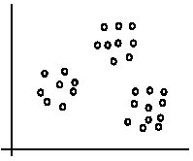
An Illustration
The data set has three natural groups of data points, i.e., 3 natural clusters.

Slide 4
What is clustering for?
Let us see some real-life examples
Example 1: Groups people of similar sizes together to make “small”, “medium” and “large” T-Shirts.
Tailor-made for each person: too expensive
One-size-fits-all: does not fit all.
Example 2: In marketing, segment customers according to their similarities

Slide 5
Example 3: Given a collection of text documents, we want to organize them according to their content similarities,
To produce a topic hierarchy
In fact, clustering is one of the most utilized data mining techniques.
It has a long history, and used in almost every field, e.g., medicine, psychology, botany, sociology, biology, archeology, marketing, insurance, libraries, etc.
In recent years, due to the rapid increase of online documents, text clustering becomes important.

Slide 6
Aspects of clustering
A clustering algorithm - Partitional clustering, Hierarchical clustering, etc.
A distance (similarity, or dissimilarity) function
Clustering quality
Inter-clusters distance maximized
Intra-clusters distance minimized
The quality of a clustering result depends on the algorithm, the distance function, and the application.

Slide 7
K-means Clustering
K-means is a partitional clustering algorithm
Let the set of data points (or instances) D be
{x1, x2, …, xn},
where xi = (xi1, xi2, …, xir) is a vector in a real-valued space - X belongs to R(r), and r is the number of attributes (dimensions) in the data.
The k-means algorithm partitions the given data into k clusters.
Each cluster has a cluster center, called centroid.
k is specified by the user

Slide 8
K-means algorithm
Given k, the k-means algorithm works as follows:
Randomly choose k data points (seeds) to be the initial centroids, cluster centers
Assign each data point to the closest centroid
Re-compute the centroids using the current cluster memberships.
If a convergence criterion is not met, go to 2.

Slide 9
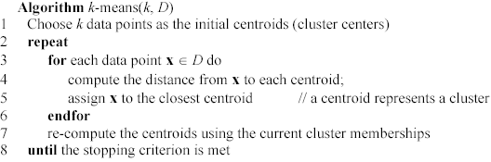

Slide 10
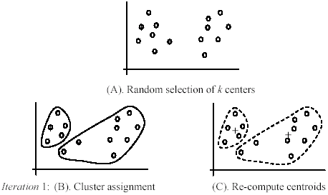
An Illustration

Slide 11
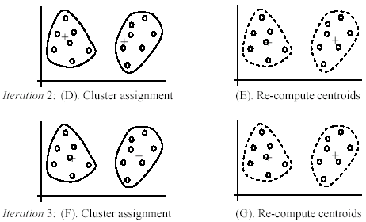
Illustration cont.

Slide 12
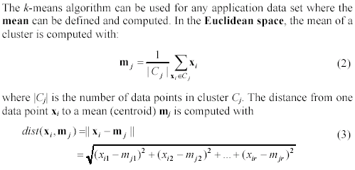
Distance Function

Slide 13
Advantages
Efficient: Time complexity: O(tkn),
where n is the number of data points,
k is the number of clusters, and
t is the number of iterations.
Since both k and t are small. k-means is considered a linear algorithm.
K-means is the most popular clustering algorithm.
Note that: it terminates at a local optimum if SSE is used. The global optimum is hard to find due to complexity.

Slide 14
Drawbacks
The algorithm is only applicable if the mean is defined.
For categorical data, k-mode - the centroid is represented by most frequent values.
The user needs to specify k.
The algorithm is sensitive to outliers
Outliers are data points that are very far away from other data points.
Outliers could be errors in the data recording or some special data points with very different values.

Slide 15
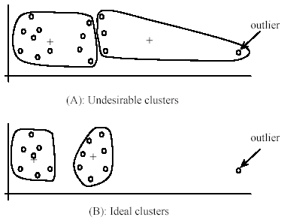
Drawbacks

Slide 16
Dealing with outliers
One method is to remove some data points in the clustering process that are much further away from the centroids than other data points.
To be safe, we may want to monitor these possible outliers over a few iterations and then decide to remove them.
Another method is to perform random sampling. Since in sampling we only choose a small subset of the data points, the chance of selecting an outlier is very small.
Assign the rest of the data points to the clusters by distance or similarity comparison, or classification

Slide 17
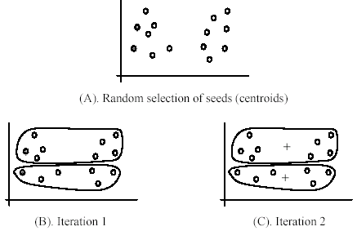
Problem with Initial seeds

Slide 18
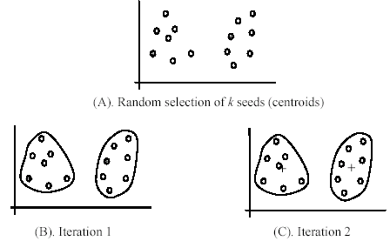
Dependence on initial seeds

Slide 19
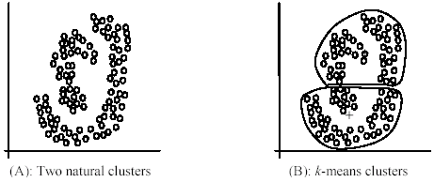
Drawbacks cont.
The k-means algorithm is not suitable for discovering clusters that are not hyper-ellipsoids (or hyper-spheres).

